Slide 1
Covering Corruption
The Difficulties of Trying to Make a Difference

Slide 2
The daunting challenges
Salaries that are low and often intermittent
No resources, even notebooks and phone minutes
Poor training and low professionalism
Owners who suffer from all of the above and may be dirty as well
A public that expects, is resigned to, or apathetic about corruption

Slide 3
And the more daunting
A government that limits access to documents, meetings and officials who will talk to the public
A government that will fine, harass, jail or bankrupt you for stories it doesn’t like
Targets bold enough to threaten, hurt or kill you

Slide 4
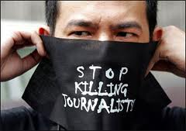
“It’s the kind of journalism that has a lot of martyrs.”
__Joel Simon, executive director Committee to Protect Journalists

Slide 5
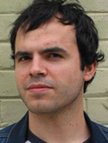
Since May
Three radio commentators killed in Philippines
South African journalist arrested
Mexican slaughter continues
Iran takes lead from China in journalists jailed

Slide 6
Newspaper to drug cartels:
We don't want any more dead. We don't want any more injured or any more threats. It is impossible to exercise our function in these conditions. Indicate to us, therefore, what you expect of us as a news outlet. –Front-page editorial in El Diario

Slide 7
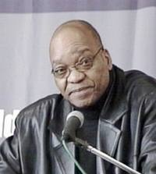
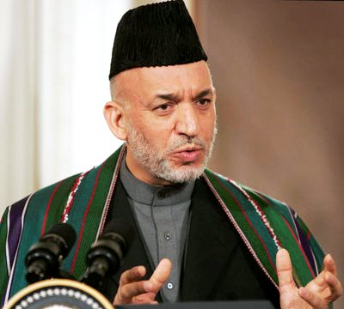
State retaliation
*South Africa
*Brazil
*Afghanistan
*Benin

Slide 8
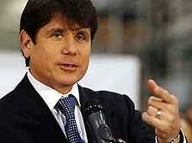
Formula for reducing corruption:
Transparent government
Media that reports on corruption
Citizens who care and understand
Citizens with mechanisms (elections and lawsuits) to punish officials

Slide 9
“Show how you will end corruption in three years”
Heller: “Impossible to know”
Kaplan: “Doomed to fail”
Kaufman: “Implies much less impact”

Slide 10
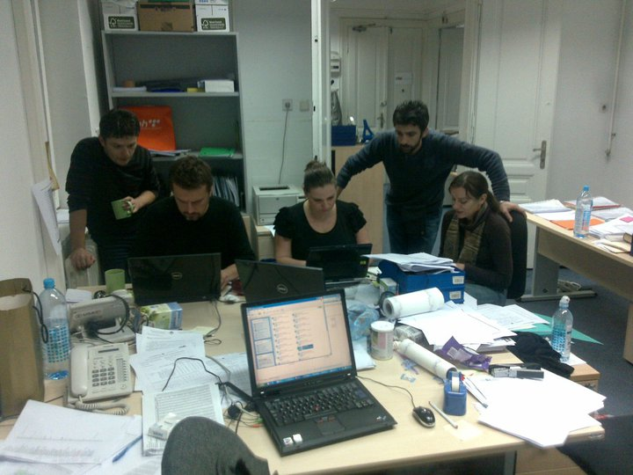
Fighting the fight
*Find the right topic
*Use technology
*Team with NGOs

Slide 11

The Right Story
Sex, food, sports, gossip, hypocrisy

Slide 12
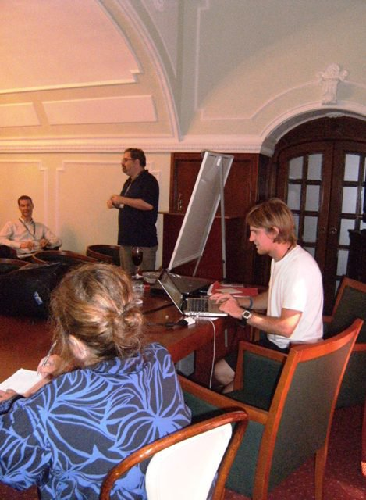
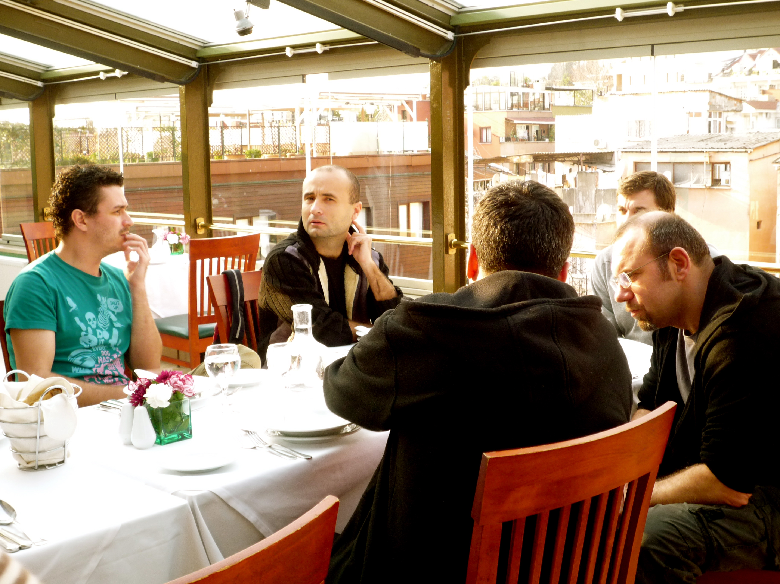
Fighting…
Build teams and networks to share resources, cross train, inspire and support

Slide 13
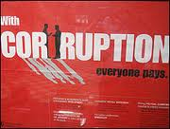
Redefine success
You can’t change what you don’t know about
Demonstrate to citizens their own responsibility for corruption

Slide 14
Redefining
Make a long-lasting record of wrong-doing
Connect corruption with the real consequences
Prevent corruption or make it harder

Slide 15
One example of how it works

Slide 16
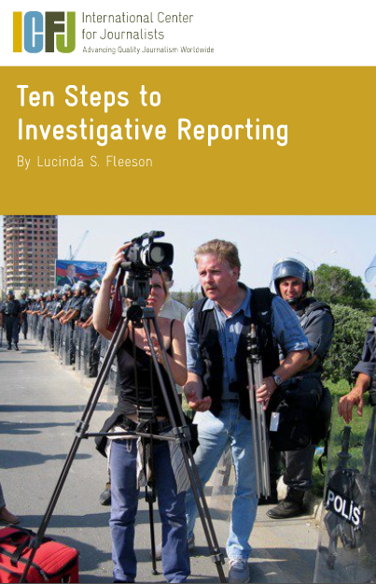
Are muckrakers born or bred?
“You can no more teach someone to be an investigative reporter who can cover corruption over a weekend than you can teach someone to practice constitutional law.” –Drew Sullivan

Slide 17
Rethink training
Train the right people
Train them for a long time
Train them outside a classroom
Work with journalism schools

Slide 18
Rethinking training
Teach budgets, cross-cultural investigation, forensic accounting
Teach interviewing and writing
But first – all the basics

Slide 19

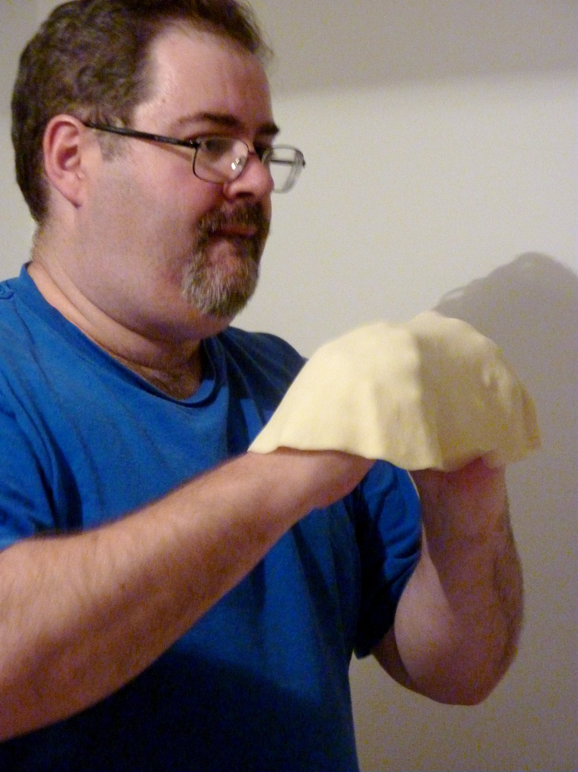
Ideal training:
How to follow companies across borders, investigate a website, background an individual, find and use business databases, write compellingly and logically (which is not cultural) and stay safe doing it

Slide 20
Technology
Collaborative software and Investigative Dashboard Model may make reporting easier
Cell-phones, social media, Internet can make sourcing and citizen participation easier when no civil society
Google Translate makes international readership easier
YouTube, crowdsourcing, citizen journalism make crusading easy

Slide 21
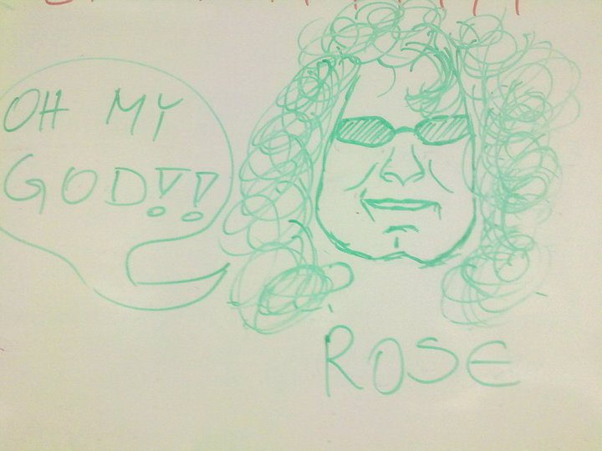
Editors are under-valued
International collaboration should be regarded in a new light
Long-term success comes from holding reporters to standards they think are too high

Slide 22
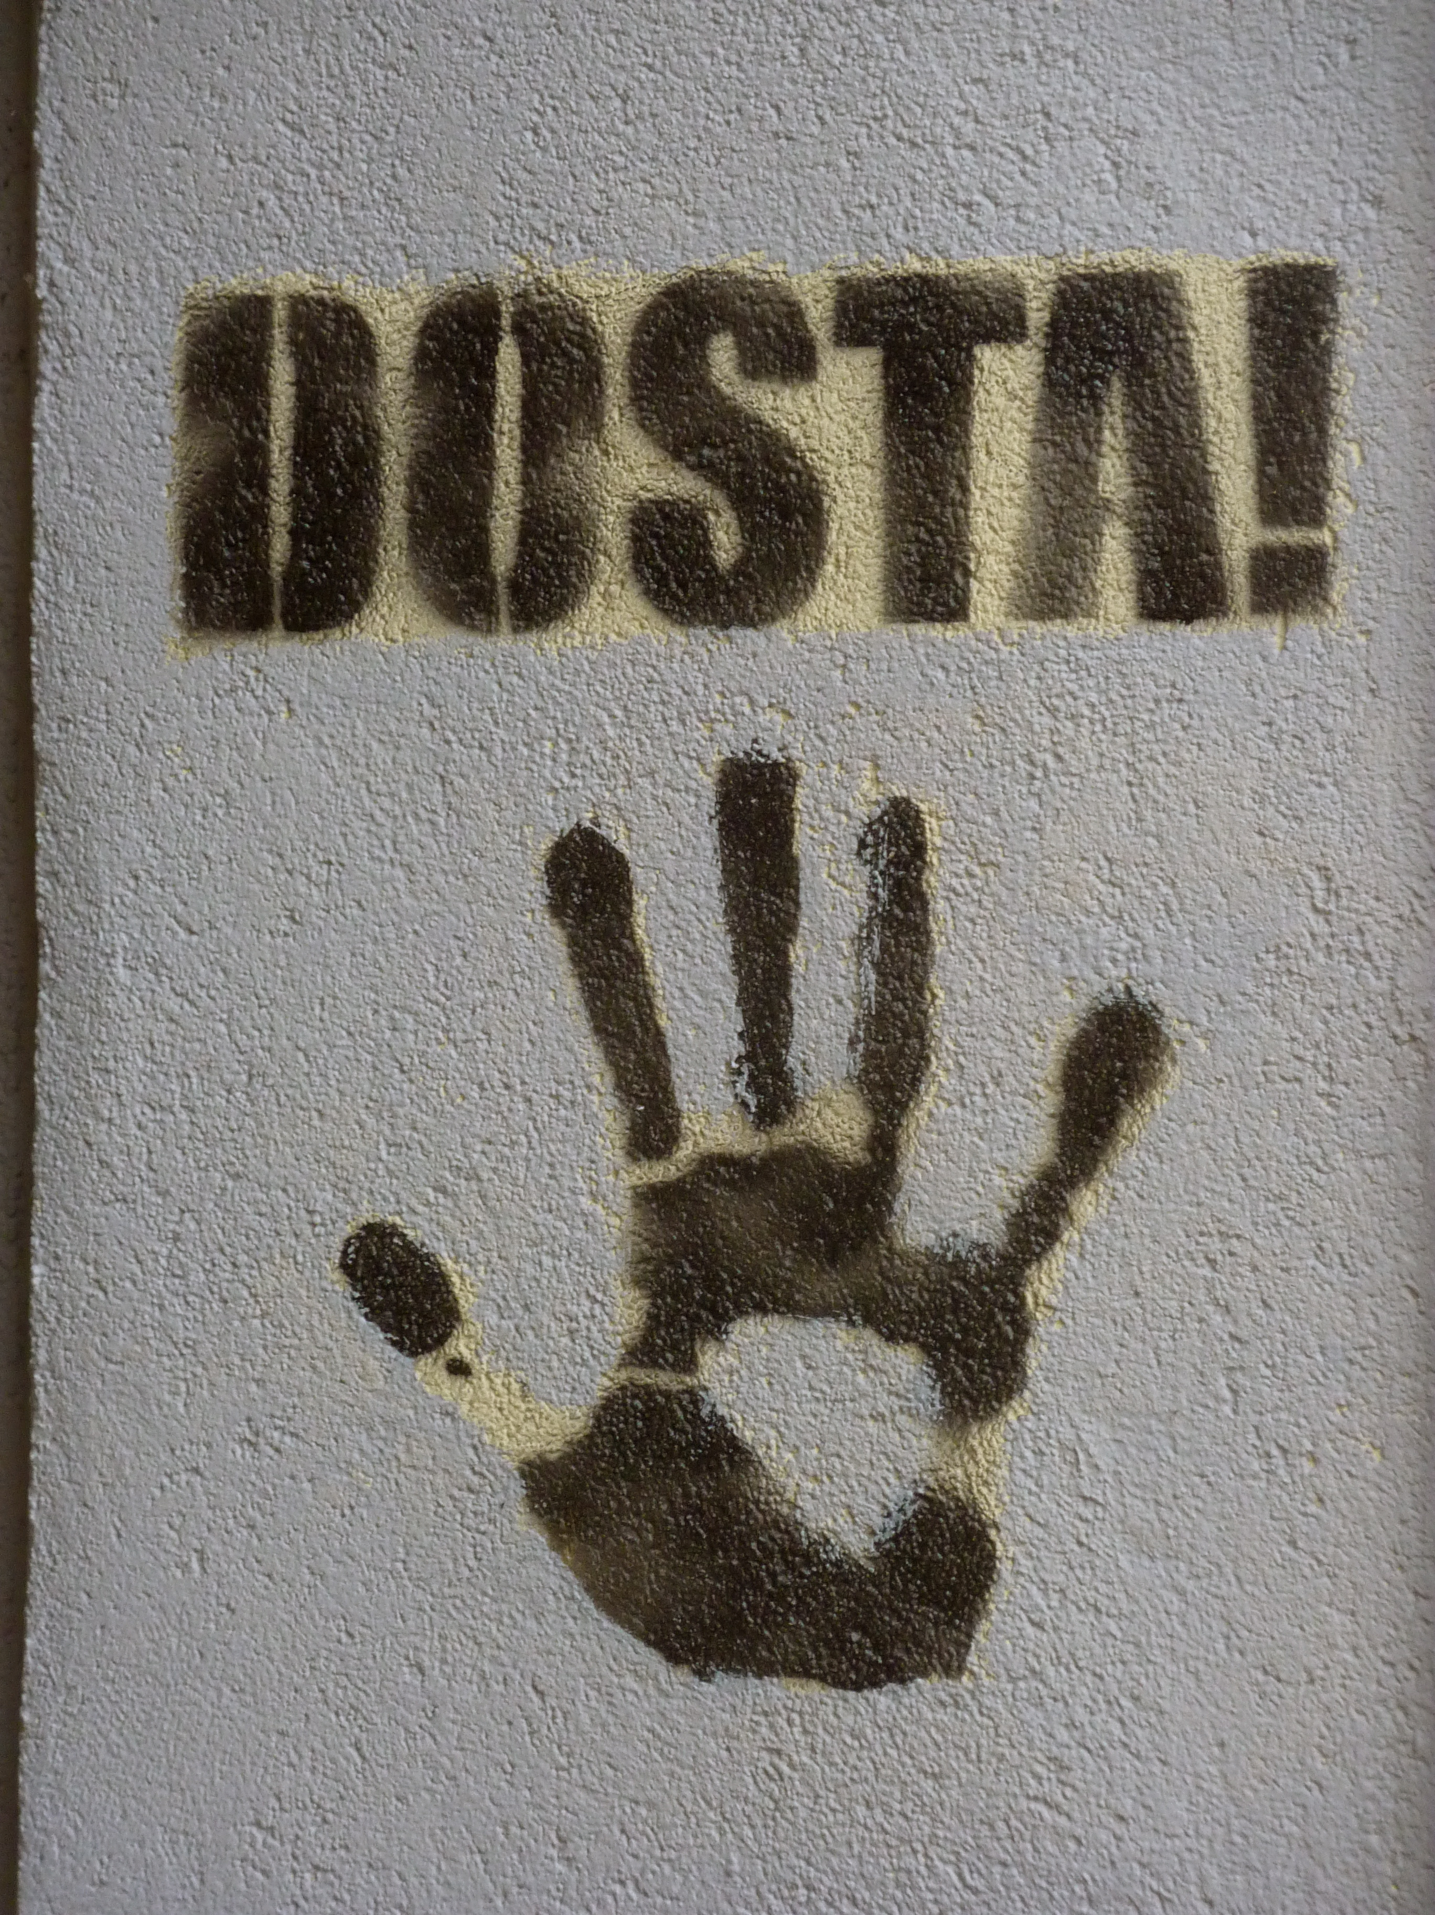
ENOUGH!

